Slide 1
Adrenergic drugs

Slide 2
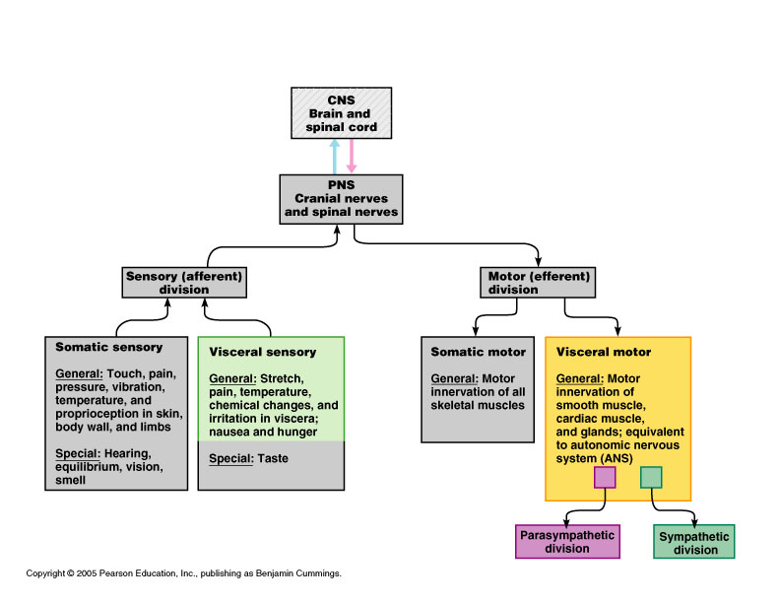
AUTONOMIC NERVOUS SYSTEM

Slide 3
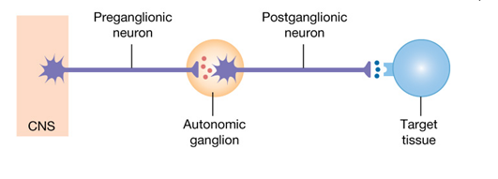
Autonomic Nervous System: Anatomy
Preganglionic neuron
Autonomic ganglion
Postganglionic neuron
Effector organ

Slide 4
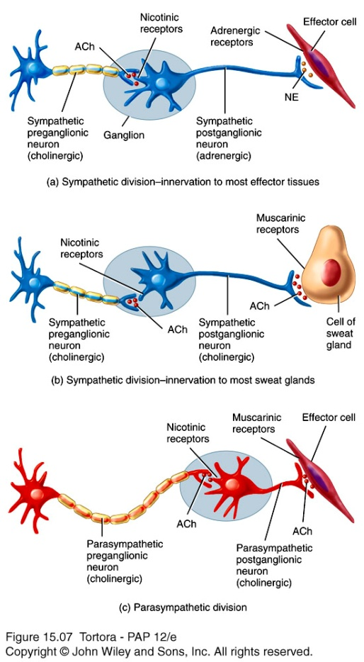
Cholinergic vs Adrenergic Neurons Neurotransmitters
All sympathetic and parasympathetic preganglionic
Sympathetic postganglionic to sweat glands.
All parasympathetic postganglionic
Adrenergic Receptors
Alpha receptors
Beta receptors
Cholinergic receptors
Nicotinic receptors
Muscarinic receptors

Slide 5
Functions of ANS
Main regulator of involuntary actions like peristalsis, accommodation, secretions
Maintenance of homeostasis (B.P, H.R, Respiration, temperature, metabolism and emotional state)
With CNS, they co-ordinate voluntary (somatic) actions
Involuntary (reflex) control is fundamental, yet voluntary control is also possible.
reverse is true somatic nervous system

Slide 6
Effects of stimulation
Sympathetic Parasympathetic
Heart rate (SAN, AVN) + -
Contractility + -
Blood glucose + none
Blood pressure + -
Pupils in eye dilates constricts
G.I motility & tone - +
G.I secretions - +
G.I sphincters constrict relax
Bronchial tree dilates constricts
Blood flow shunt none

Slide 7
Adrenergic receptors
The adrenergic receptors (or adrenoceptors) are a class of receptors that are targets of the catecholamines.
They specifically bind their endogenous ligands, the catecholamines adrenaline and noradrenaline (also called epinephrine and norepinephrine).
Agonists to these receptors cause a sympathetic response (i.e. the fight-or-flight response). E.g.
heart rate increases
pupils dilate,
energy is mobilized,
blood flow is diverted from other non-essential organs to skeletal muscle.

Slide 8
Classification of Adrenergic receptors
There are 2 main grps of adrenergic receptors, α & β, with several subtypes giving a total of 5 categories namely:
α receptors - α₁ & α₂.
β receptors - β₁, β₂ & β₃.
Common agonists Effects of α-receptors:
Vasoconstriction of coronary artery
Vasoconstriction of veins
Decrease motility of smooth muscle in GIT

Slide 9
α-receptors
α₁ receptor
Its specific actions mainly involves smooth muscle contraction. It causes vasoconstriction in many blood vessels of the:
- skin, - GIT, - kidney
- brain. - Ureter - vas deferens
- uterus (pregnant) - bronchioles
It also causes:
glycogenolysis and gluconeogenesis
secretion from sweat glands
Na+ reabsorption from kidney
Examples of α₁ agonists
Noradrenaline o Phenylephrine
Xylometazoline o Oxymetazoline
Methylnorepinephrine

Slide 10
α-receptors
α₂ receptor
Its specific actions include:
contraction of sphincters of the GIT
Examples of α₂ agonists
Clonidine
Methyldopa

Slide 11
β-receptors
β₁ receptor
Its specific actions:
Increase cardiac.
Renin release from juxtaglomerular cells.
Lipolysis in adipose tissue.
Examples of β₁ Agonists
Noradrenaline
Isoprenaline
Dobutamine
Isoproterenol (β1 and β2)
β₁ agonists are used to treat cardiogenic shock, acute heart failure, bradyarrhythmias.

Slide 12
β₂ receptor
Its specific actions:
Smooth muscle relaxation, e.g. in bronchi
Dilate arteries to skeletal muscle
Glycogenolysis and gluconeogenesis
Thickened secretions from salivary glands.
Inhibit histamine-release from mast cells
Examples of β₂ Agonists
Salbutamol o Isoprenaline
Salmeterol o Terbutaline
o Fenoterol o Formoterol
β₃ receptor enhances lipolysis in adipose tissue

Slide 13
Adrenergic drugs
Adrenergic drugs either stimulate a response (agonists) or inhibit a response (antagonists).
An adrenergic agonist is a medicine, or substance, which has effects similar to, or the same as, epinephrine (adrenaline).
Epinephrine and norepinephrine are endogenous and broad-spectrum.

Slide 14
Mechanisms of Action of Adrenergic Agonists
Adrenergic agonists are broadly classified into 3, and these
have separate MOAs
(1) Direct-acting Agonists
These act directly on α, or β receptors producing effects similar to those that occur following stimulation by sympathetic nerves or release of adrenaline from the adrenal medulla.
(2) Indirect-acting Agonists
These are taken up into presynaptic neuron and cause the release of noradrenaline from the cytoplasmic pools or vesicles of the adrenergic neuron. The noradrenaline then traverses the synapse and binds to the α or β receptors.
(3) Mixed-action Agonists
These have the capacity both to directly stimulate adrenoceptors and release of noradrenaline from the adrenergic neuron.

Slide 15
Classification of Adrenergic Agonists
Adrenergic
Agonists
A
B
C
Direct-Acting
Indirect- Acting
Mixed Action
Alpha-
Adrenergic
Adrenaline
Noradrenaline
Phenylephrine
Methoxamine
Xylometazoline
Clonidine
Uanfacine
Beta-
adrenergic
Noradrenaline
Isoprenaline
Salbutamol
Terbutaline
Isoproterenol
Amphetamine
Tyramine
Ephedrine
Pseudoephedrine
Metaraminol

Slide 16
Direct acting adrenergic agonists
These include Alpha-adrenergic and Beta-adrenergic agonists
(a) Alpha-Adrenergic (b) Beta-Adrenergic
Adrenaline
Noradrenaline o Noradrenaline o Phenylephrine o Isoprenaline
Methoxamine o Salbutamol
Xylometazoline o Terbutaline
Clonidine
Uanfacine
These agonists bind to adrenergic receptors without interacting with the presynaptic neuron.

Slide 17
(1) ADRENALINE
It is one of the 5 catecholamines used in therapy
The entire list includes:
Adrenaline
Noradrenaline
Dopamine
Dobutamine
Isoproterenol exogenous
Adrenaline interacts with both α and β receptors.

Slide 18
ACTIONS OF ADRENALINE
(a) Cvs
The major actions of adrenaline are on the CVS
it strengthens the contractility of the myocardium ( inotropic β1 action) and increases its rate of contraction( chronotropic). this increases the cardiac output and cardiac oxygen demand
it decreases renal blood flow
(b) Respiratory system
it causes powerful bronchodilation by acting directly on bronchial smooth muscles (β₂ action).
This is very important in relieving dyspnea (laboured breathing) in asthma and can be life-saving in anaphylactic shock.

Slide 19
ACTIONS OF ADRENALINE
(c) Lipolysis
it initiates lipolysis through its agonist activity on the β receptors of adipose tissue

Slide 20
THERAPEUTIC USES OF ADRENALINE
(a) Bronchospasm
It is used in the treatment of asthma and anaphylactic shock
Terbutaline is now most favoured for these treatments because of its longer duration of action and minimal cardiac stimulatory effects.
(b) Glaucoma
It is used as a topical medicine to reduce intra-ocular pressure in open-angle glaucoma. it does so by reducing the production of aqueous humour by vasoconstriction of the cilliary body blood vessels

Slide 21
THERAPEUTIC USES OF ADRENALINE
(c) Anaphylactic shock
It is the drug of choice for the treatment of Type1 hypersensitivity reactions in response to allergens.
(d) In anaesthetics
Local anesthetics normally contain 1:100,000 parts adrenaline so as to increase the duration of the local anaesthesia
It does this by producing vasoconstriction at the site before being absorbed into circulation and metabolised

Slide 22
Pharmacokinetics of Adrenaline
Adrenaline has a rapid onset but brief duration of action
In emergency situations it is given IV for the most rapid onset of action.
It may also be admn sc, by inhalation, or topically
It cannot be admn orally
Its metabolites are excreted via the kidney (in urine)

Slide 23
Side effects
Allergic reactions e.g. skin rash, itching
Breathing problems
Chest pain or palpitations
Cardiac arrythmias
Flushing (reddening of the skin)
Pulmonary oedema
Cerebral haemorrhage
Tingling,
Numbness in the hands or feet
Vomiting
Anxiety or nervousness
Headache
Nausea

Slide 24
(2) NORADRENALINE
It has dual roles as a hormone & a neurotransmitter.
It increases heart rate, triggering the release of glucose, and increasing blood flow to skeletal muscle.
when it acts as a drug it increases BP by its prominent increasing effects on the vascular tone (due stimulation of alpha-Receptors).
When given in therapeutic doses, noradrenaline acts more on the α-receptors
It causes a rise in peripheral resistance due to intense vasoconstriction of most vascula beds including the kidney.
Both systolic and diastolic BPs increase

Slide 25
Therapeutic Uses of Noradrenaline
It is used to treat shock since it increases vascular resistance and therefore, increases BP.
NB: Dopamine is better in this case because it does not reduce renal blood flow as does noradrenaline
Its other actions are not of clinical significance.

Slide 26
(3) Clonidine
Clonidine is a direct-acting α2 adrenergic agonist prescribed historically as an antihypertensive agent.
It has found new uses:
treatment of neuropathic pain,
opioid detoxification,
sleep hyperhidrosis,
anaesthetic use,
It can be used for treatment of insomnia, & relief of menopausal symptoms.

Slide 27
Clinical uses
It used to treat high BP.
It works by stimulating α2 receptors in the brain which decreases cardiac output and peripheral vascular resistance, lowering blood pressure.
It has specificity towards the presynaptic alpha-2 receptors in the vasomotor center in the brainstem.
This binding decreases presynaptic calcium levels, and inhibits the release of norepinephrine. The net effect is a decrease in sympathetic tone.
preparations
Clonidine tablets and transdermal patch
It is available as tablets, transdermal patches or injection

Slide 28
Pharmacodynamics
Clonidine has more affinity for α₂ than α₁.
It selectively stimulates receptors in the brain that monitor catecholamine levels in the blood.
The result is a lowered heart rate and blood pressure.
NB: If suddenly withdrawn, the sympathetic nervous system will revert to producing high levels of epinephrine and norepinephrine, higher even than before treatment, causing rebound hypertension.

Slide 29
Side effects
This drug may cause
drowsiness,
lightheadedness,
dry mouth,
dizziness,
constipation.
hypotension.
Reduced libido in women.

Slide 30
(b) Beta-Adrenergic (1) ISOPROTERENOL
This is a directing acting synthetic catecholamine that predominantly stimulates β1 & β2 adrenergic receptors
Its actions on α1 is insignificant
Its unspecificity is its clinical drawback
Actions of Isoproterenol
CVS
It produces intense stimulation of the heart to increase its rate and force of contraction, causing increased cardiac output.
It also dilates the arterioles of skeletal muscles resulting in a decrease in peripheral resistance.

Slide 31
(1) ISOPROTERENOL
Pulmonary Effects
It produces a profound and rapid bronchodilation
Isoproterenol is as active as adrenaline and rapidly alleviates an acute attack of asthma
This effects may last for 1 hr.
Pharmacokinetics
It is absorbed systemically by sublingual mucosa but is more reliably admn parenterally or as an inhalation.
Adverse Effects
Its side effects are similar to those of adrenaline

Slide 32
(2) TERBUTALINE
Terbutaline is a β2-adrenergic receptor agonist, used as a fast-acting bronchodilator (often used as a short-term asthma treatment)
The inhaled form of terbutaline starts working within 15 minutes and can last up to 6 hours.
Terbutaline may be used as a tocolytic to delay/treat premature labour
It is routinely prescribed to stop contractions.

Slide 33
Side effects
tachycardia,
nervousness,
tremors,
headache,
hyperglycemia,
hypokalemia,
pulmonary edema.

Slide 34
(3) SALBUTAMOL
Salbutamol is a short-acting β2-adrenergic receptor agonist used for the relief of bronchospasm in conditions such as asthma and chronic obstructive pulmonary disease.
It is usually given by the inhaled route for direct effect on bronchial smooth muscle by use of a metered dose inhaler (MDI), nebuliser or other proprietary delivery devices
Its maximal effect is 5 – 20 min. of dosing.
It can also be given orally as an inhalant or intravenously.

Slide 35
Clinical uses
It is specifically indicated for:
Acute asthma
Protection against exercise-induced asthma
As a β2-agonist, it can be used as a tocolytic to relax the uterine smooth muscle to delay premature labour.
Side Effects
Tachycardia
Tremors
nervousness
Headache
Insomnia
Nausea and Vomiting
Drowsiness

Slide 36
Indirect acting adrenergic agonists
These include:
Amphetamine
Tyramine
(1) Amphetamine:
Amphetamine, and related drugs such as methamphetamine are a grp of drugs that act by increasing levels of norepinephrine, serotonin, and dopamine in the brain
It is used to treat symptoms of traumatic brain injury and the daytime drowsiness symptoms of narcolepsy and chronic fatigue syndrome.
Initially it was more popularly used to diminish the appetite and to control weight.

Slide 37
Indications
Beneficial effects include;
improved impulse control,
improved concentration
treatment for narcolepsy, and other sleeping disorders
Side-effects
loss of appetite tend to decrease over time.
addiction or physical dependence.

Slide 38
Contraindications
May elevate cardiac output & BP hence dangerous in patients with heart disease or hypertension.
In patients with a history of drug dependence or anorexia.
Not suitable for patients with a history of glaucoma.

Slide 39
Physical effects of amphetamine
o include reduced appetite, o hyperactivity,
o dilated pupils, o flushing,
o restlessness, o dry mouth,
o erectile dysfunction, o tachycardia,
o increased breathing rate, o increased BP
o fever, o diarrhea,
o constipation, o blurred vision,
o dizziness, o tremors/shaking,
o insomnia, o numbness,
o palpitations, o dry or itchy skin,
o acne,

Slide 40
(2) Tyramine
Tyramine can cause the release of stored monoamines, such as dopamine, norepinephrine, and epinephrine.
It occurs widely in plants & animal
Foods containing Tyramine:
spoiled, aged, smoked, or fermented meat
pork,
alcoholic beverages,
cheeses,
yogurt, beans, avocados, bananas, raspberries, peanuts,

Slide 41
Mixed action adrenergic agonists (1) Ephedrine
Ephedrine is used as a stimulant, appetite suppressant, concentration aid, decongestant, and to treat hypotension associated with anaesthesia.
It is an alkaloid derived from various plants in the genus Ephedra
Mode of action
It has direct and indirect actions on the adrenergic receptor system.

Slide 42
Clinical use
Ephedrine was widely used as a topical decongestant and as a bronchodilator in asthma.
As a nasal decongestion it has largely been replaced by more potent α-receptor agonists (e.g. oxymetazoline).
In asthma, its mainly replaced by β2-adrenergic receptor agonists (e.g. salbutamol).
Its used in the reversal of hypotension from spinal/epidural anaesthesia.
It can be used in narcolepsy and nocturnal enuresis.
It has been used together with promethazine to combat seasickness. Promethazine manages nausea and ephedrine fights the ensuing drowsiness.

Slide 43
Adverse effects
tachycardia, cardiac arrhythmias,
Angina pectoris, hypertension
flushing, sweating, acne vulgaris
nausea, appetite loss
restlessness, confusion,
insomnia, mild euphoria,
hallucinations , delusions,
hostility, panic,
agitation dyspnea,
pulmonary edema dizziness,

Slide 44
Pseudoephedrine
Pseudoephedrine is a sympathomimetic amine commonly used
It relieves nasal congestion commonly associated with colds or allergies.
The advantage of oral pseudoephedrine over topical nasal preparations, such as oxymetazoline, is that it does not cause rebound congestion (rhinitis medicamentosa); however, it is more likely to cause adverse effects including hypertension.
Pseudoephedrine is being phased out as an over-the-counter drug in some countries and replaced by alternative decongestants like phenylephrine

Slide 45
Mode of action
its principal MOA relies on its indirect action on the adrenergic receptor system. The principal mechanism is to cause the release of endogenous noradrenaline from storage vesicles.
When activiated by pseudoephedrine, the muscles contract, causing vasoconstriction.
This allows less fluid to leave the blood vessels and enter the nose, throat and sinus linings, which results in decreased inflammation of nasal membranes as well as decreased mucous production.
Thus, pseudoephedrine causes a decrease in the symptoms of nasal congestion.
Unlike all sympathomimetic amines, it shows greater selectivity for the nasal mucosa and a lower affinity for CNS adrenergic-receptors.

Slide 46
Clinical use
Pseudoephedrine is indicated for the treatment of:
nasal congestion
sinus congestion
Eustachian tube congestion.
vasomotor rhinitis,
as an adjunct in treatment of allergic rhinitis, sinusitis, otitis media, and tracheobronchitis.
as first-line therapy of priapism.
Treatment for urinary incontinence

Slide 47
Adverse effects
CNS stimulation,
sleeplessness,
nervousness,
excitability,
dizziness and anxiety.
tachycardia
palpitations
hallucinations
arrhythmias
hypertension
seizures
severe skin reactions

Slide 48
The end
Thanks for listening

